Slide 1
End-to-End Credit Risk Pipeline on Azure : DAMG 7370 Final Project
Presented by Group 5-
Abdul Mohsin Ahmed
Mohammed Zaheeruddin Akhtar Siddiqui
Syed Abdul Azeem

Slide 2
Project Overview
This project presents a comprehensive end-to-end data pipeline designed to analyze credit risk using Microsoft Azure services. The pipeline leverages a publicly available credit risk dataset containing demographic, financial, and loan-related features to determine the likelihood of loan default.
Starting with data ingestion through Azure Data Factory, the raw CSV file is stored in the Bronze layer of Azure Data Lake Storage Gen2.
Data is then cleaned and transformed in Azure Databricks and saved to the Silver layer.
From there, structured views are created in Synapse Analytics (Gold layer) to enable fast querying and external table creation. These curated datasets are finally visualized in Power BI to uncover patterns in default behavior based on factors such as income, loan amount, interest rate, and credit history.
The solution showcases a scalable, cloud-based data architecture suitable for real-time financial analytics and business intelligence.

Slide 3
Project Vision
To build a robust, scalable, and cloud-native data architecture that empowers financial institutions to analyze, monitor, and predict credit risk with accuracy and efficiency.
By leveraging Azure's ecosystem—including Data Factory, Databricks, Synapse Analytics, and Power BI—this project aims to transform raw loan and customer data into actionable insights.
The ultimate goal is to support smarter lending decisions, minimize default risks, and enhance business intelligence capabilities through seamless data integration and visualization.

Slide 4
About the Dataset
The Credit Risk dataset used in this project contains over 32,000 records of loan applicants and includes 13 key features related to personal demographics, financial status, and loan attributes.
The dataset covers variables such as age, income, home ownership, employment length, loan purpose, loan amount, interest rate, credit history length, and prior default history. The target variable is loan_status, which indicates whether a loan was defaulted (1) or repaid (0).
This dataset is ideal for supervised machine learning, risk segmentation, and exploring behavioral lending patterns, making it highly suitable for financial risk analysis and predictive modeling.

Slide 5
Why this dataset matters ?
The Credit Risk dataset was selected for its real-world relevance, rich feature set, and strong alignment with financial risk analytics—a critical domain in data-driven decision-making. With clear indicators of loan performance and well-structured variables such as income, loan amount, credit history, and default status, the dataset offers meaningful opportunities for both exploratory data analysis and predictive modeling.
Additionally, its size and diversity make it ideal for building an end-to-end data pipeline in Azure, showcasing the power of cloud technologies in solving practical business problems related to credit risk evaluation.

Slide 6
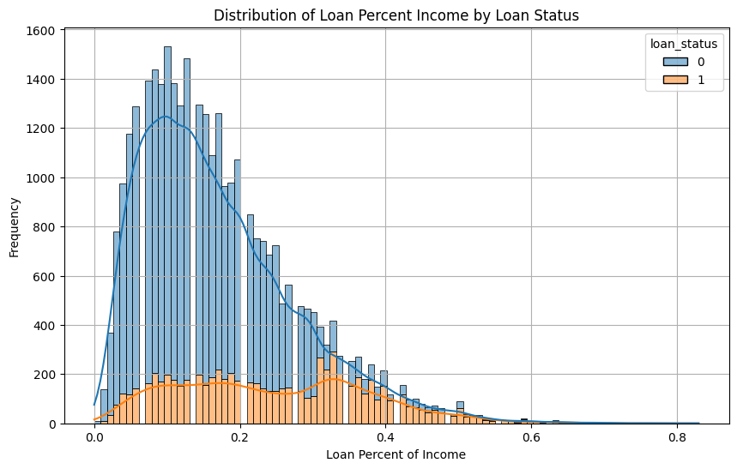
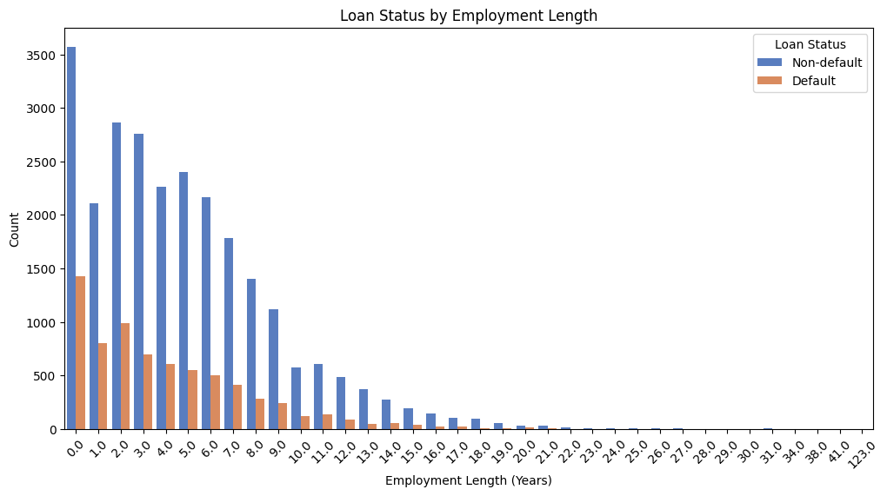
Loan % Income by Loan Status
The first visualization highlights that borrowers with a higher loan percent of income are more likely to default, especially beyond the 0.2 threshold. This suggests that as loans consume a larger portion of a borrower's income, the risk of default increases significantly. The second chart shows a clear pattern: shorter employment length is associated with higher default rates. Borrowers with less than 5 years of employment history account for the majority of defaults, reinforcing the importance of income stability in credit risk assessment.

Slide 7
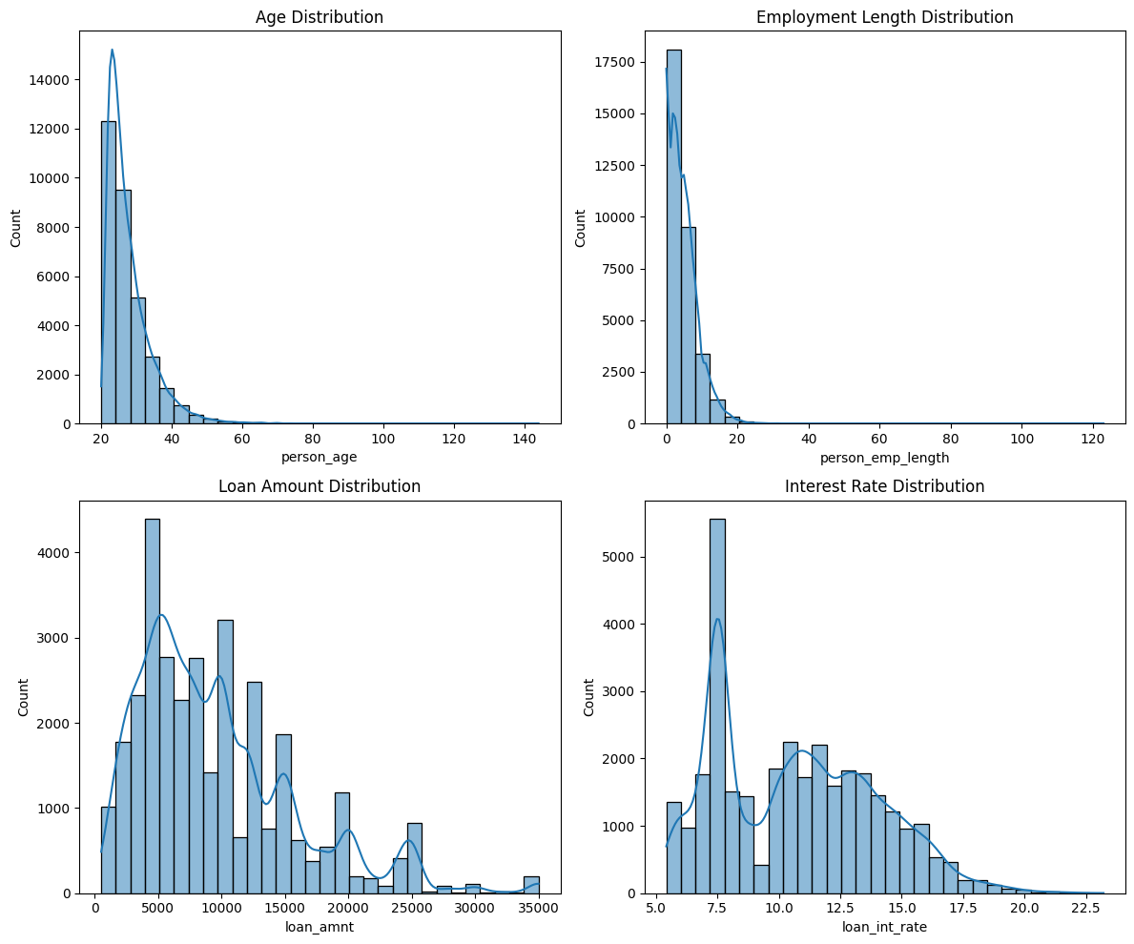
Distributions (Age, Loan, Employment)
This visualization provides insights into four important numerical features. The age distribution shows most borrowers are between 20 and 40 years old. Employment length is heavily skewed towards individuals with under 10 years of experience. The loan amount distribution peaks around 5,000 to 10,000, with a gradual drop for higher amounts. Lastly, interest rates show a concentration between 6% to 12%, suggesting standard lending patterns for mid-risk borrowers. These trends help define the borrower profile and shape model assumptions.

Slide 8
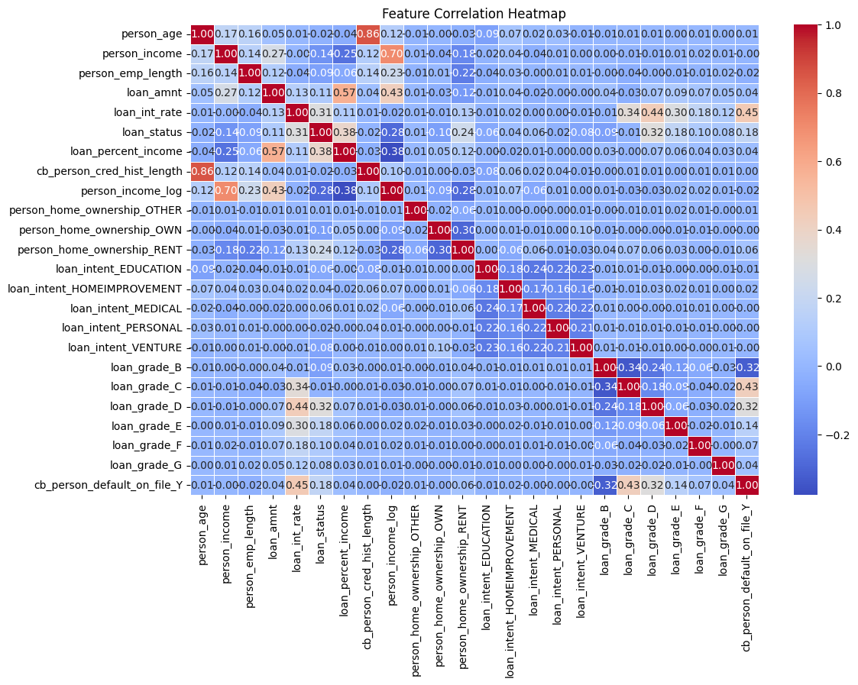
Feature Correlation Heatmap
This heatmap provides a holistic view of how various features—both numerical and encoded categorical—interrelate within the credit risk dataset. A strong positive correlation is evident between person_age and cb_person_cred_hist_length, which is intuitive since older individuals tend to have longer credit histories. Clusters of moderate correlation appear among loan grades, especially from B to G, suggesting grading consistency. However, most features show weak correlation with the target variable loan_status, indicating that predicting defaults is not straightforward and requires advanced modeling techniques. This reinforces the importance of feature selection, transformation, and deeper analysis to improve predictive power in our pipeline.

Slide 9
Pipeline
Our pipeline follows a modern, modular data architecture designed for scalability, transparency, and ease of maintenance. We began by sourcing the dataset from Kaggle, hosting it on GitHub for dynamic accessibility. Using Azure Data Factory, we ingested the dataset into the Bronze layer of Azure Data Lake Gen2. From there, Azure Databricks was used for data cleaning, transformation, and analysis—storing the refined results in the Silver layer. Structured views and external tables were created in Azure Synapse Analytics (Gold layer) for optimized querying and integration. Finally, we connected this architecture to Power BI for interactive visualizations. This layered approach not only separates raw, cleaned, and curated data but also follows industry-standard practices for building robust data lakes.

Slide 10
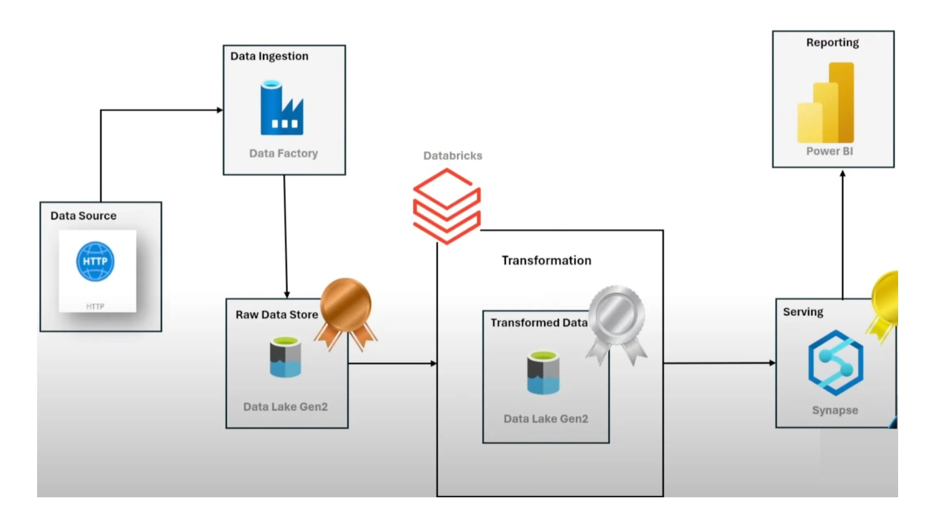

Slide 11
Tech Stack Overview
Tools & Technologies Used:
Azure Data Factory: Ingest data from online sources
Azure Databricks: Clean, transform, and structure the data
Azure Synapse Analytics: Store, query, and prepare for consumption
Power BI: Visualize trends and deliver business intelligence

Slide 12
Data Flow
Our data pipeline follows a structured flow through multiple Azure services, ensuring clean and optimized data delivery for analysis:
Data Ingestion (Bronze Layer)
The raw dataset was sourced from GitHub and ingested into Azure Data Lake Gen2 using Azure Data Factory.
Stored in the Bronze container as-is to preserve the original format for traceability.
Data Transformation (Silver Layer)
The data was mounted and processed using Azure Databricks.
Cleaning steps included handling null values, formatting dates, feature creation, and writing results in Parquet format to the Silver container.
Structured Data Access (Gold Layer)
Azure Synapse Analytics was used to create SQL views on Silver layer files.
Views were converted into external tables using CETAS for stable and efficient access.
Data Visualization (Power BI)
Power BI connected directly to Synapse external tables.
Dashboards were created to visualize default patterns, risk factors, and borrower insights in an interactive format.
This modular data flow ensures data is clean, reusable, and scalable—supporting both technical workflows and business decision-making.

Slide 13
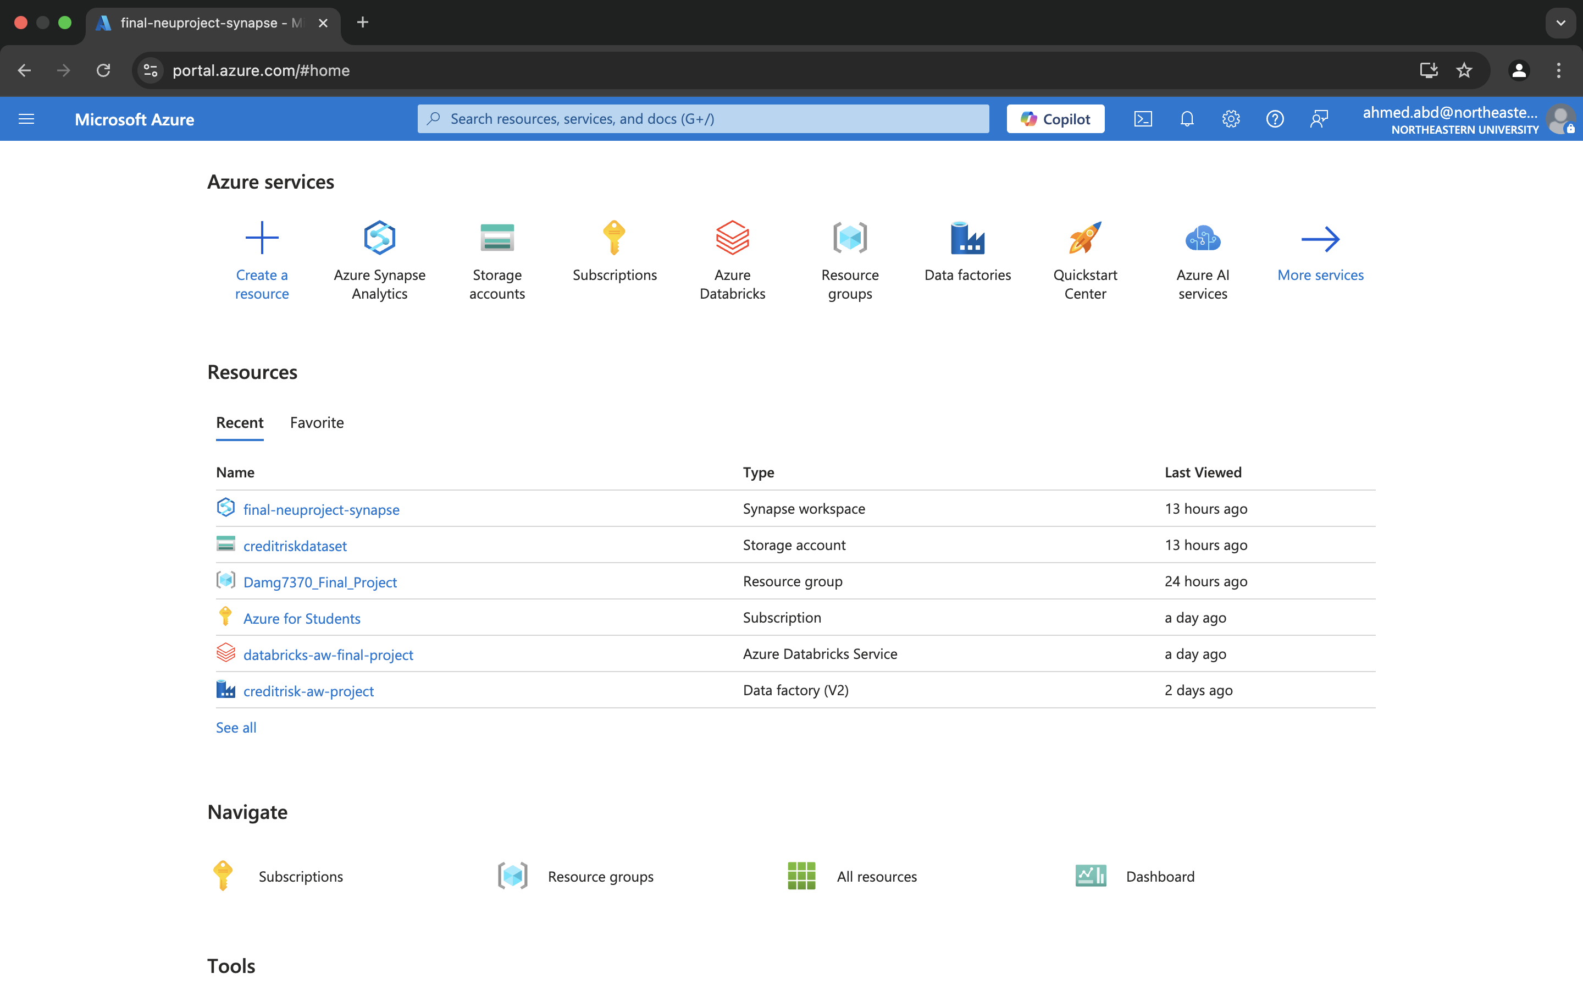
Microsoft Azure
We leveraged Microsoft Azure for its powerful cloud-based architecture, seamless scalability, and integrated analytics services. Azure enabled us to implement an end-to-end data pipeline efficiently—from ingesting raw data using Azure Data Factory, to transforming and cleaning it with Azure Databricks, and finally structuring and serving it through Azure Synapse Analytics. Its native support for Data Lake Gen2 ensured secure, cost-effective storage across bronze, silver, and gold layers. Azure's modular tools allowed us to automate workflows, manage large volumes of data, and prepare it for reporting and visualization in Power BI, making it the ideal platform for our data engineering project.

Slide 14
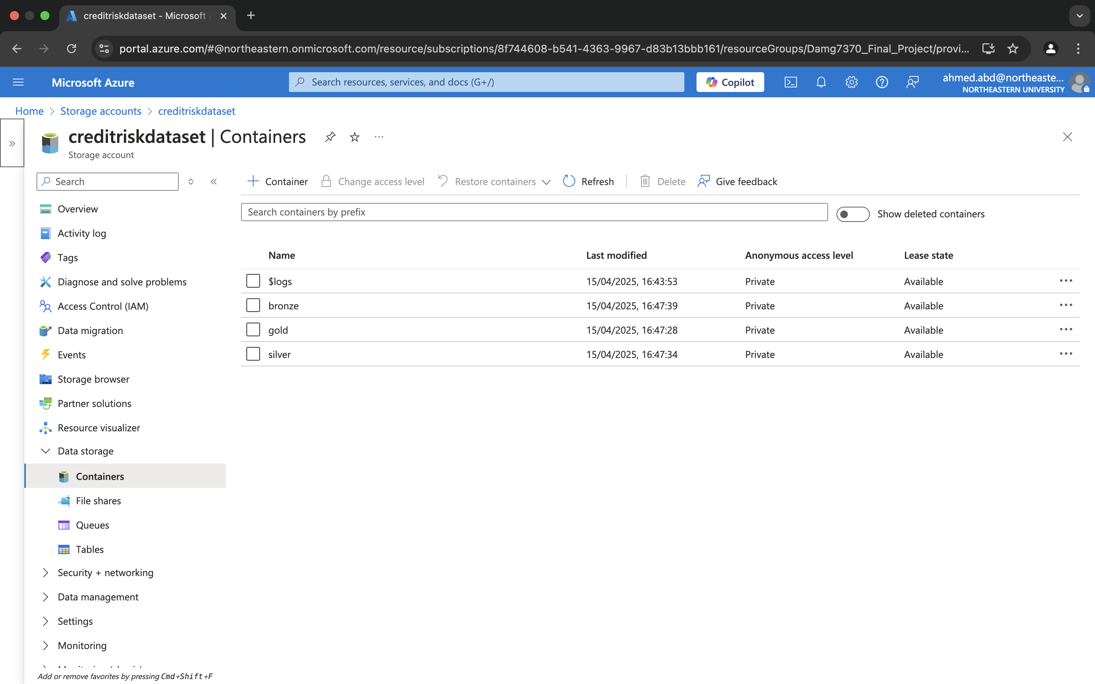
Azure Data Containers
To manage our data pipeline effectively, we used Azure Data Lake Gen2 containers structured into three layers: Bronze, Silver, and Gold.
Bronze holds the raw ingested data directly from the source (GitHub via Azure Data Factory), enabling traceability and reprocessing when needed.
Silver stores cleaned, formatted, and deduplicated data using Azure Databricks, ready for advanced analysis.
Gold contains highly curated, analytics-ready data exposed as views and external tables via Synapse for direct consumption in Power BI.
We chose this layered architecture to maintain data quality, lineage, and scalability, making the entire pipeline modular, transparent, and production-ready.

Slide 15
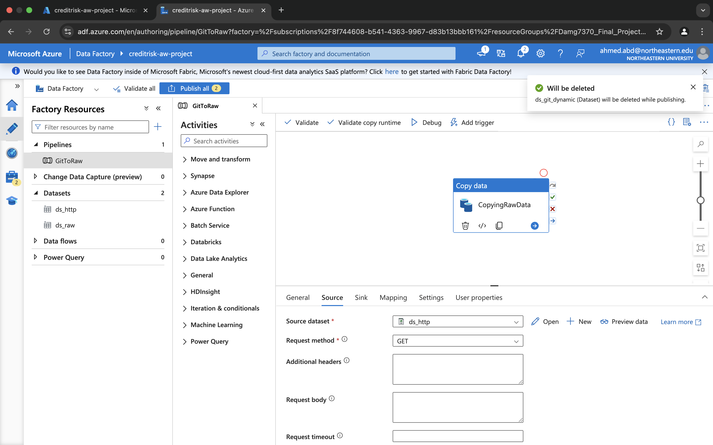
Azure Data Factory
Our data pipeline begins with Azure Data Factory, a powerful ETL tool that automates data movement. We used ADF to ingest data from a GitHub repository and store it in the Bronze layer (raw data container) of Azure Data Lake Gen2.
Key Steps in the Data Flow:
Step 1: Configure HTTP Linked Service to connect to the GitHub raw CSV URL.
Step 2: Create Source Dataset (ds_http) and Sink Dataset (ds_raw) to define the endpoints.
Step 3: Build a pipeline using the Copy Data activity, transferring the dataset from GitHub to the Bronze container.
This approach allowed us to fetch a single CSV file directly from a version-controlled source and securely store it in Azure for downstream processing.

Slide 16
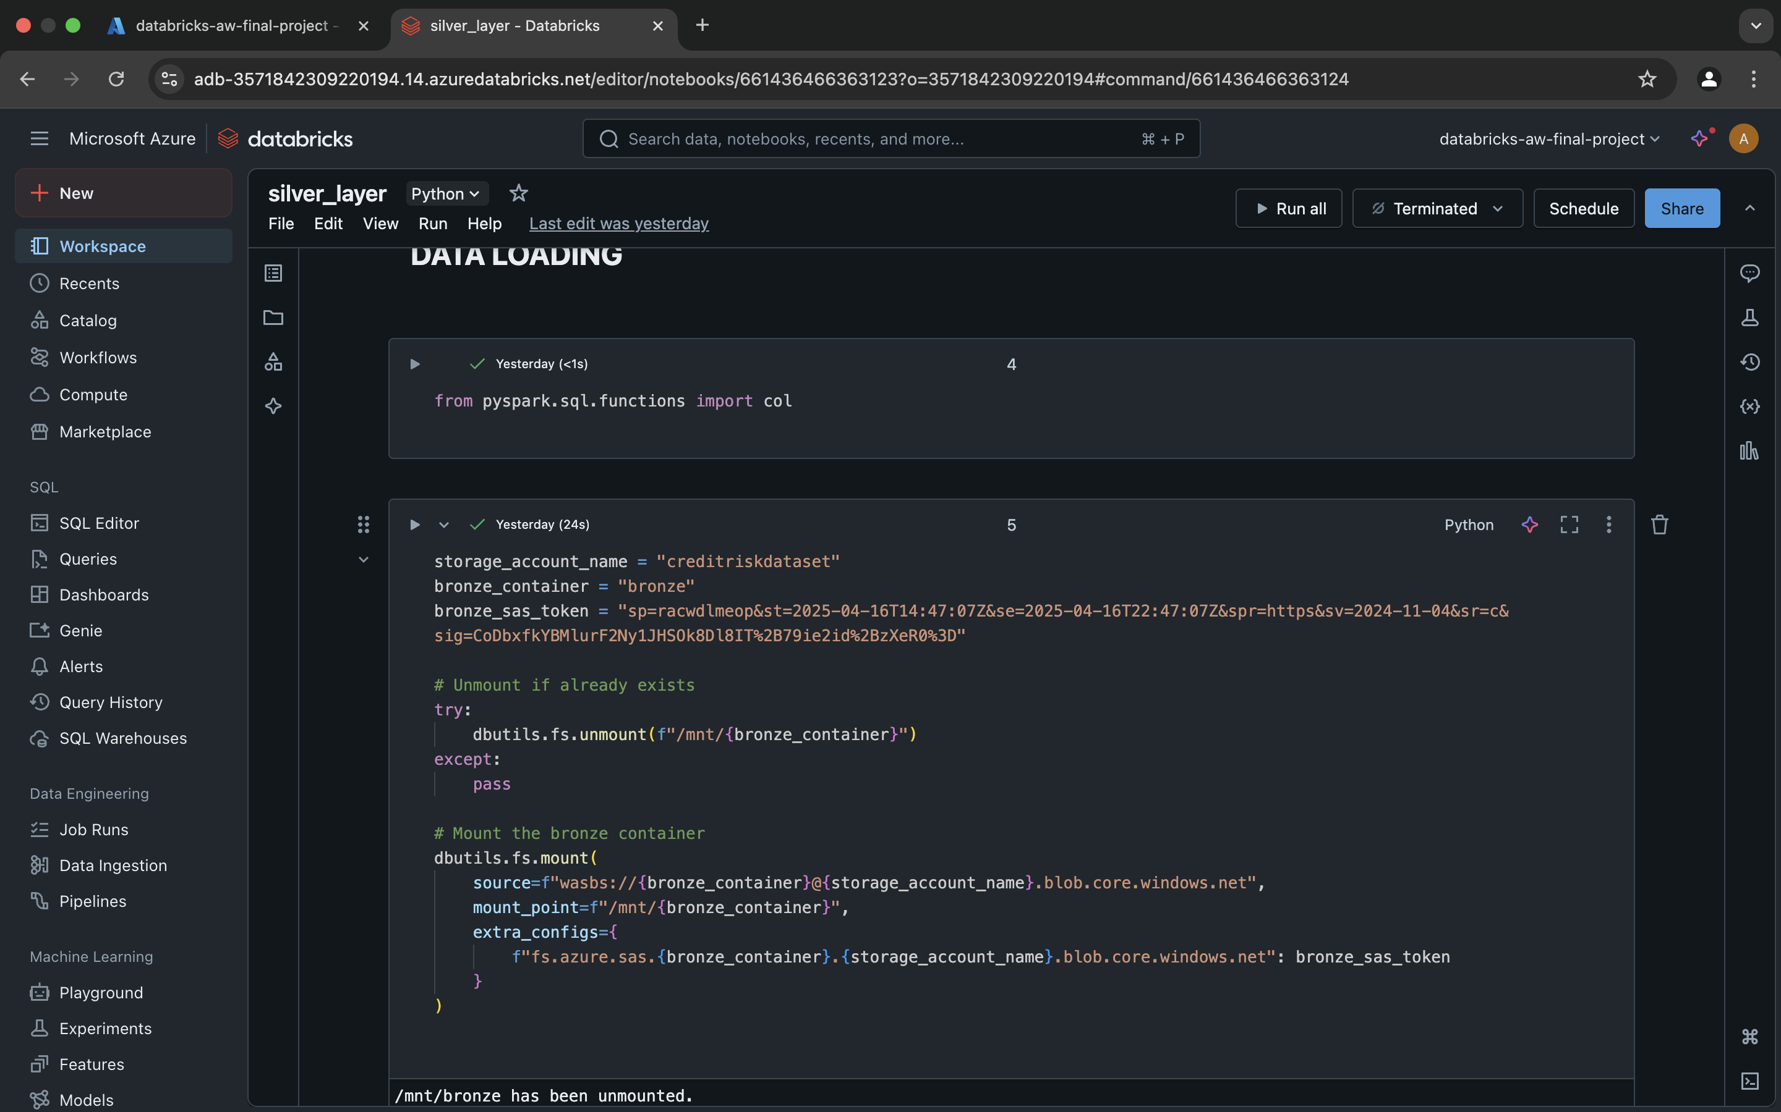
Azure databricks
We used Azure Databricks for data preparation due to its scalable Apache Spark engine, seamless Azure integration, and support for collaborative notebooks. Databricks enabled us to clean and transform large datasets efficiently in a distributed environment.
Key Steps:
Mounting the Bronze container using dbutils.fs.mount() with a secure SAS token, giving direct access to raw data stored in Azure Data Lake.
Data Cleaning Tasks included:
Handling missing values
Formatting and parsing date fields
Creating new features (e.g., monthly loan changes)
Saving the processed output in Parquet format to the Silver container
We chose Databricks for its flexibility, performance, and ability to handle structured and unstructured data seamlessly—all while staying within the Azure ecosystem.

Slide 17
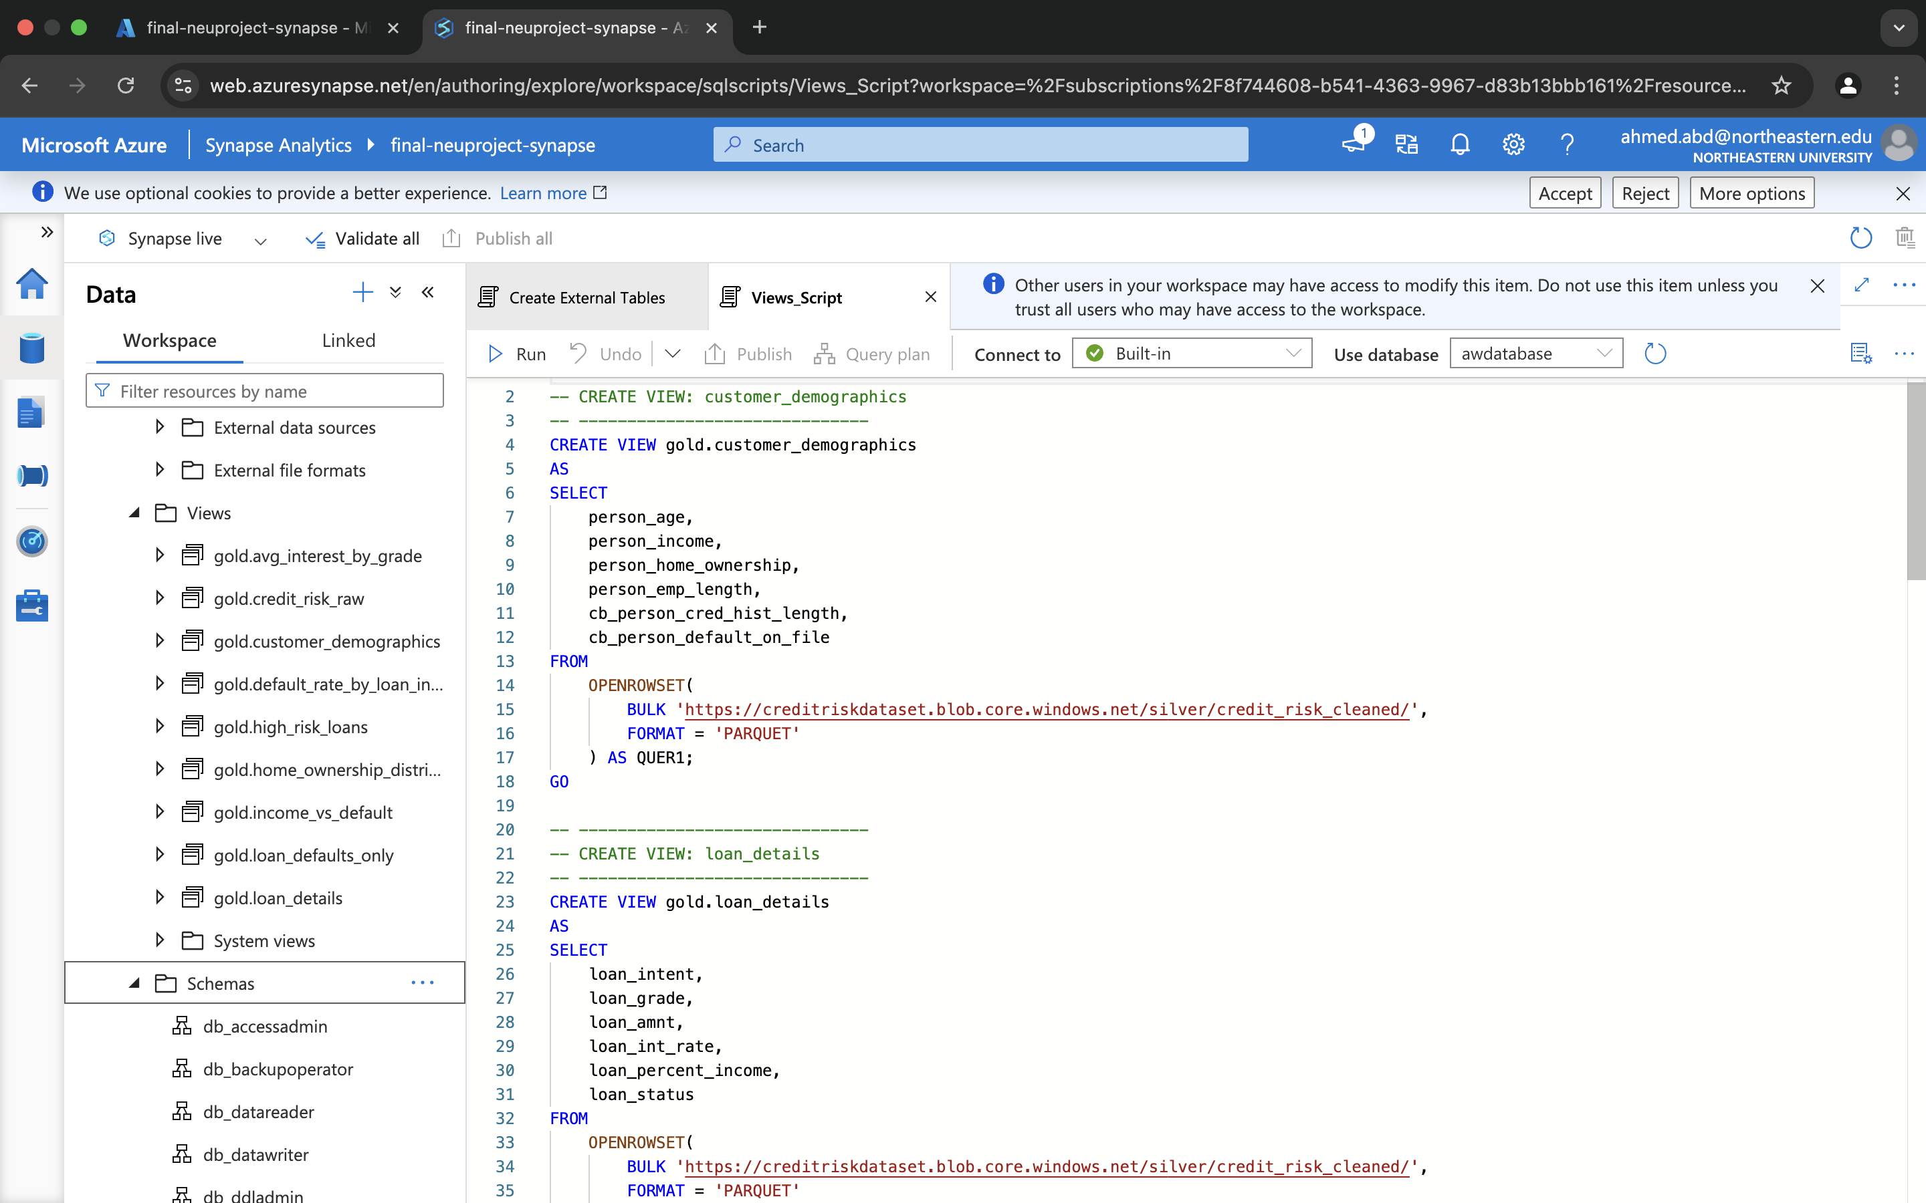
Azure Synapse
We used Azure Synapse Analytics for its ability to seamlessly query large datasets stored in Azure Data Lake using serverless SQL. Synapse allowed us to create SQL views over the cleaned Parquet files in the Silver layer, enabling fast, structured, and scalable access to curated data without duplication.
Using the Silver layer ensured that our views were built on cleaned and transformed data, avoiding inconsistencies from raw input. These views served as the foundation for Power BI visualizations, supporting reusable logic, simplified queries, and consistent reporting for all stakeholders. Synapse played a key role in bridging the gap between cloud storage and analytical consumption.

Slide 18
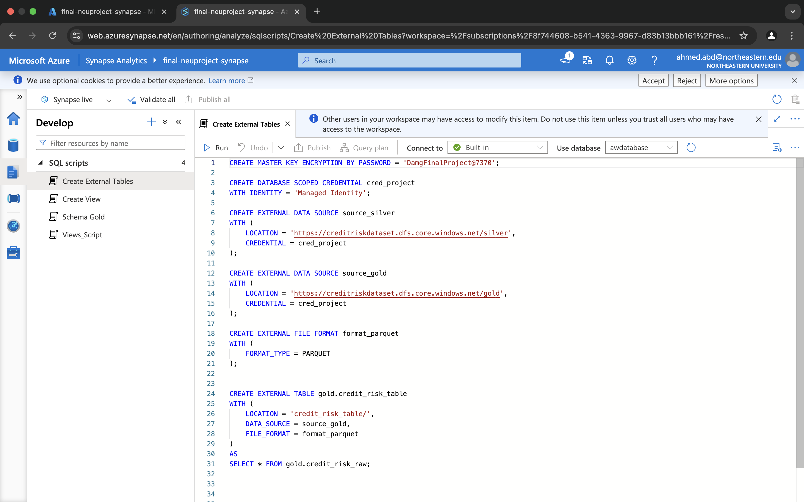
Azure Synapse – External Tables for Power BI Integration
To enable seamless data access from Power BI, we used external tables in Azure Synapse. Unlike views, external tables provide a physical reference to Parquet files in the Gold layer, making them easily discoverable and queryable by reporting tools like Power BI.
We created external tables using CETAS (Create External Table As Select) from our Synapse views, ensuring the data was pre-structured, optimized, and accessible without relying on OPENROWSET or credentials bound to individual user sessions. This approach eliminated permission issues during Power BI access and significantly improved performance.
By using external tables, we bridged the gap between data engineering and data visualization, enabling a robust, low-latency reporting layer that could scale to multiple users and dashboards.

Slide 19
Power Bi
We used Power BI as the final layer of our pipeline to transform structured data into actionable insights. Power BI’s seamless integration with Azure Synapse external tables allowed us to connect directly to curated datasets without manual uploads or refresh issues.
We chose Power BI for its interactive dashboards, support for real-time querying, and easy sharing across team members. It enabled us to visualize trends such as default rates by income, loan grade, employment length, and loan intent, helping uncover key risk segments in the dataset. Power BI served as the analytical front-end of our project, making insights accessible and understandable to both technical and non-technical users.

Slide 20
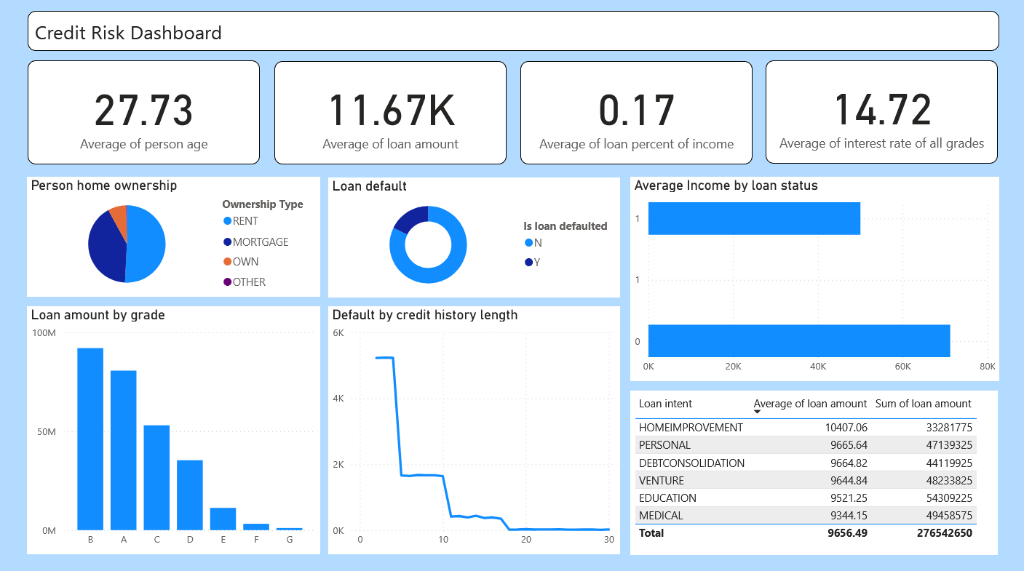

Slide 21
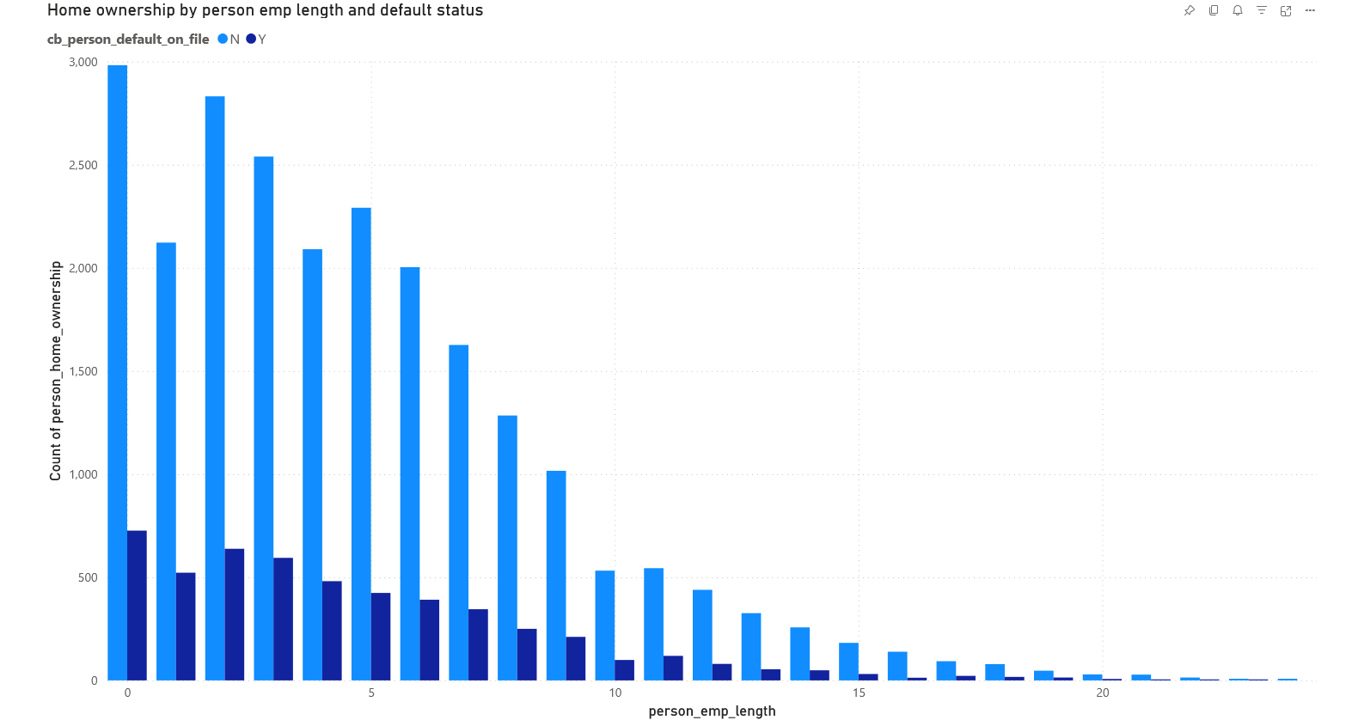
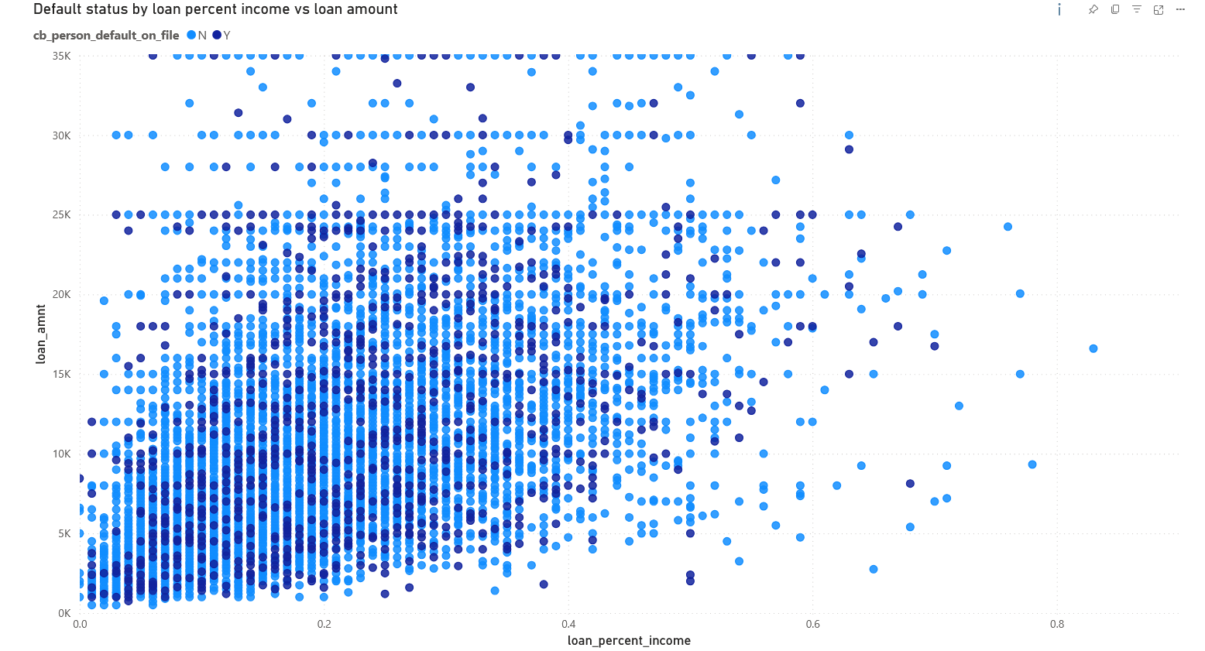
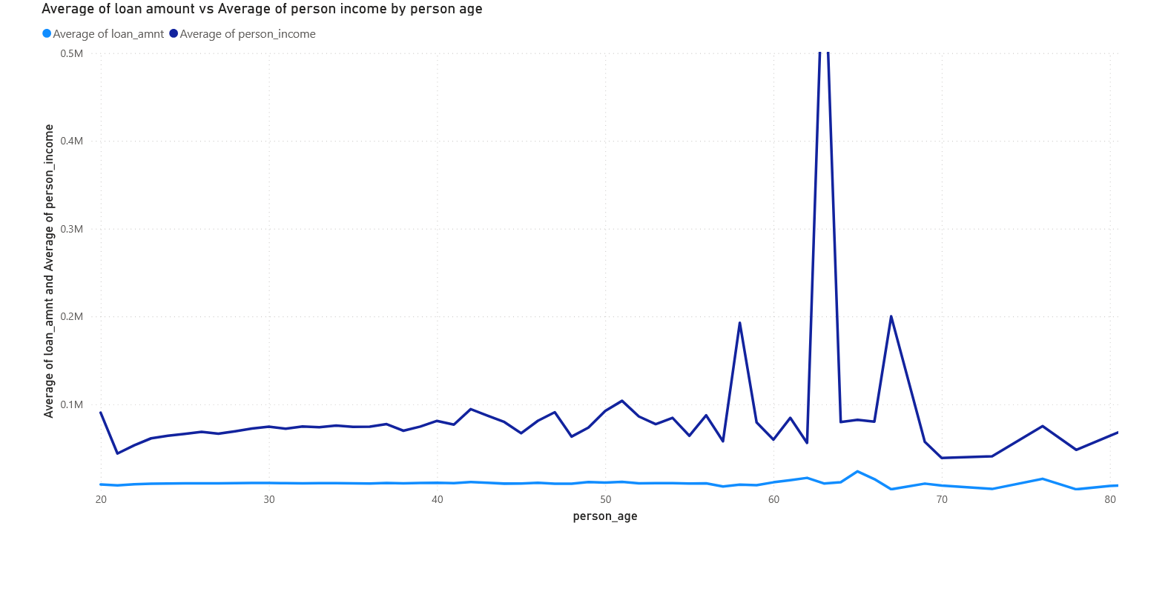
Loan default Insight

Slide 22
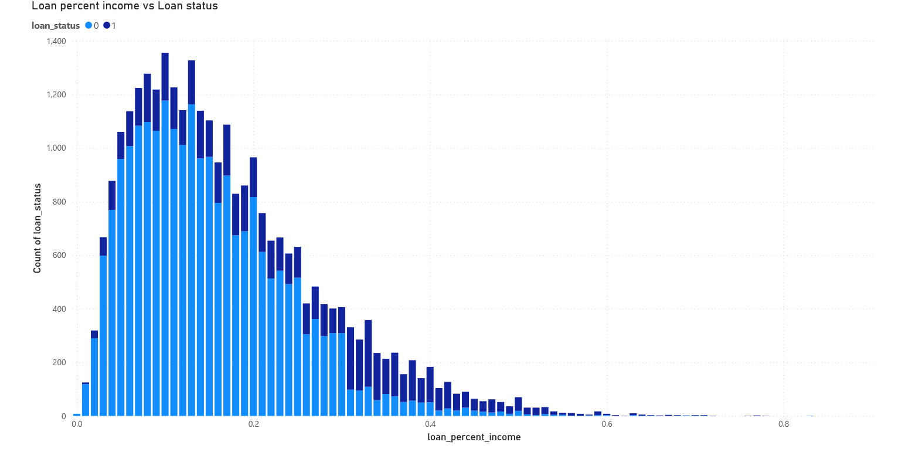
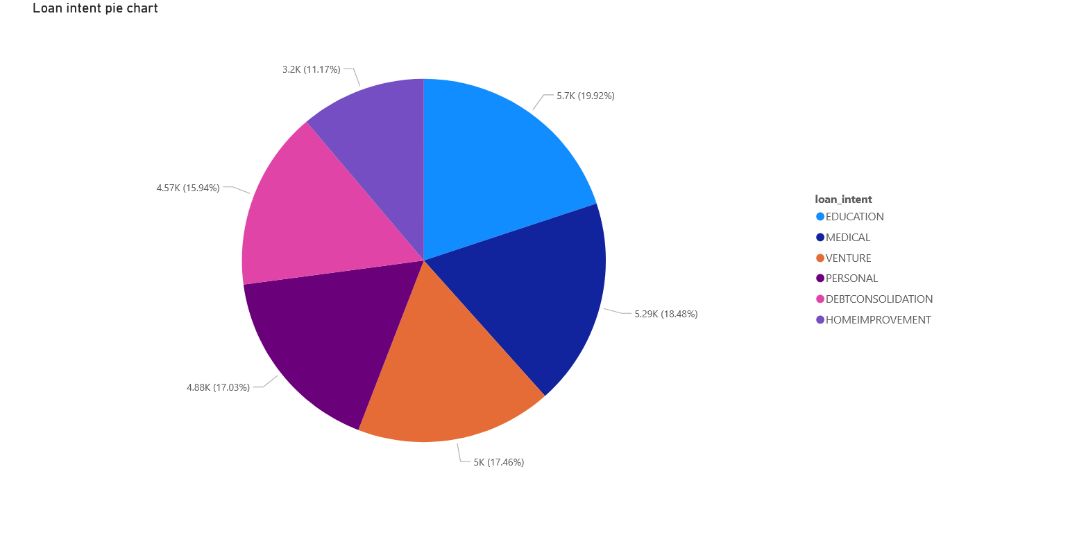
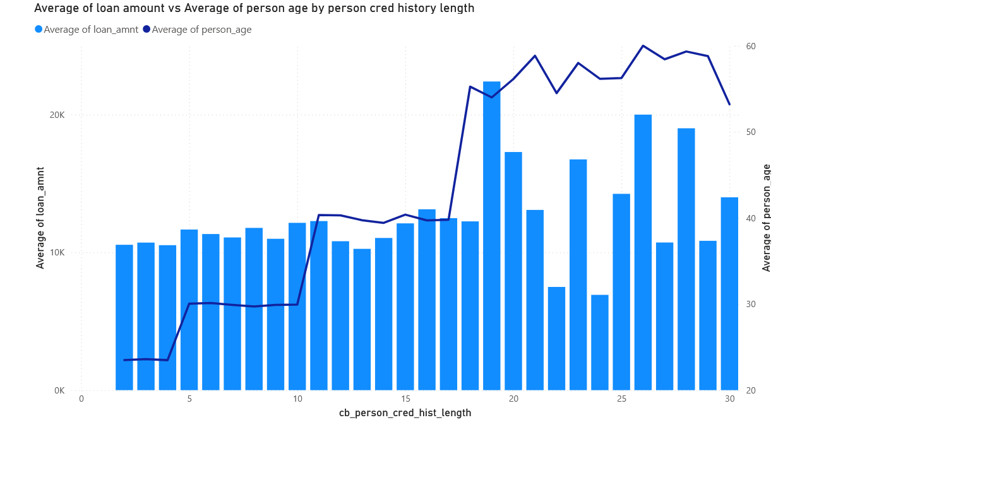
Person Insight

Slide 23
Team Contribution
Our team collaborated closely throughout all phases of the project, ensuring shared ownership, equal effort, and smooth execution of the entire Azure-based data pipeline.
Mohammed Zaheer Uddin Akhtar Siddiqui
Participated in data ingestion, transformation, and reporting
Contributed to Power BI by preparing datasets, validating relationships, and assisting with layout design
Ensured consistency between Synapse external tables and dashboard metrics
Abdul Mohsin
Engaged in all stages from dataset processing to reporting
Assisted with Databricks transformations, view creation in Synapse, and Power BI integration
Contributed to documentation, testing, and validation of pipeline components
Azeem Syed
Took part in data ingestion, EDA, and reporting
Worked on setting up external tables, building dashboards, and enhancing interactivity
Helped coordinate end-to-end flow and ensure presentation quality.
Together, we delivered a robust and collaborative implementation, with each team member actively contributing to the technical, analytical, and visual components of the project.

Slide 24
Challenges and Difficulties Encountered
Throughout the project, we faced several technical and coordination-related challenges:
Databricks VM Stockouts: Faced resource availability issues while creating clusters, requiring multiple region and node type changes.
Power BI Access Errors: Encountered credential binding issues when accessing Synapse views, which led us to switch to external tables for stable integration.
IAM Role Management: Had to carefully configure Azure role assignments (Storage Blob Data Contributor, Synapse Contributor) to enable multi-user access across services.
Mounting Issues: Initial difficulties with mounting the storage in Databricks due to token expiration and path configuration.
Learning Curve: Navigating the integration of multiple Azure services (ADF, Databricks, Synapse) demanded continuous learning and troubleshooting.
Despite these obstacles, the team was able to troubleshoot effectively and implement a fully functional data pipeline.

Slide 25
Key Takeaways & Future Roadmap
Summary: This project successfully delivered a cloud-based pipeline to analyze credit risk using a combination of Azure tools, big data engineering, and statistical insights. It demonstrated how large-scale financial data can be cleaned, structured, and transformed into actionable intelligence using an end-to-end architecture.
What’s Next:
Integrate machine learning models for real-time risk prediction
Automate the pipeline for scheduled or live data refresh
Enhance Power BI dashboards with interactive filters and drill-down capabilities
Explore integration with loan approval systems or automated alert mechanisms for high-risk applicants

Slide 26
Thank you
GitHub Repo Link:-
https://github.com/Zaheeruddin2832558/DAM7370_Final_Project

